Slide 1
6.2 Literacy / Numeracy Assessment Approaches, Challenges and Solutions In preparation please: •Turn on your cameras •Ensure your microphone is muted to maintain audio quality •Introduce yourself using the chat – Let us know your name, where you come from and what your role is there!
Tuesday, 17th May 2022
Notes:
ANAHERA
Nau mai ki te whare korero
Tupuranga Ngaio, Reatanga Ngaio kia tū māia ake ai te hunga whakaako
Ānei nga Tikanga Whakahaere Huitopa
Whakaaturia mai tō kanohi mataora, wetohia tāu hopuoro (kia pai ai te rongo o te katoa)
Patohia tētahi kōrero whakapiri, mihi rānei (pēnei ki: ko Mātai Hautaia ahau, kei Ūawa, Tai Rāwhiti ahau e whakaako ana i ngā ākonga tau 9 - 10
Me mōhio, ka whakamau mātou i ngā kōrerorero o tēnei huitopa

Slide 2
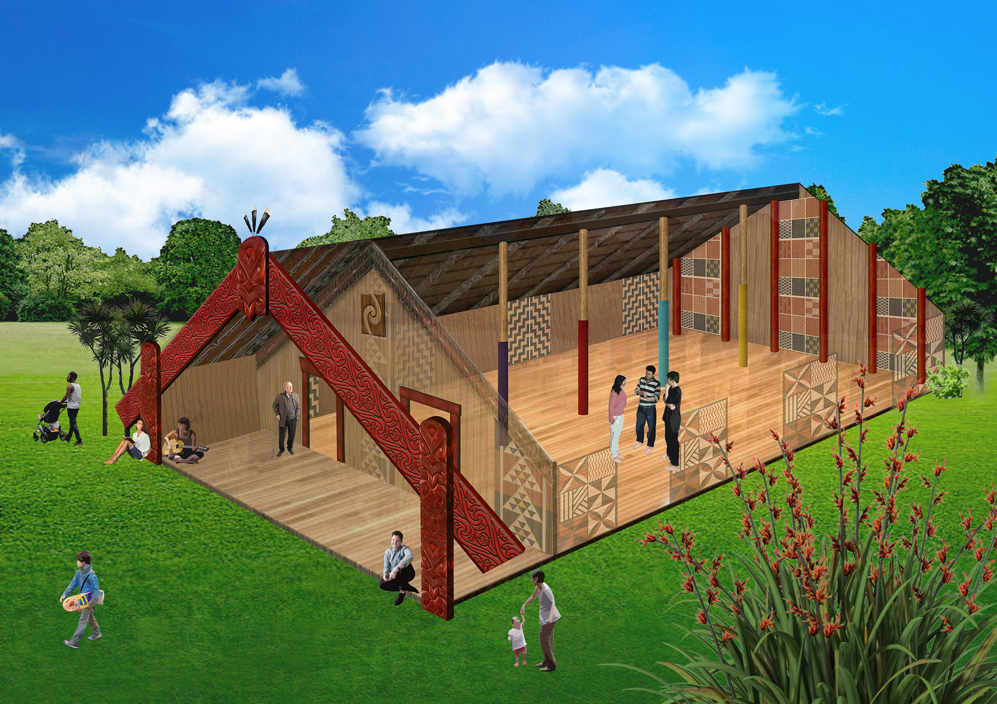
Notes:
The whare is held up by ngā pou o te whare | the pillars of the house – which depict the work that needs to be undertaken to contribute to a strong and effective profession. The four central pou represent the values of the teaching profession and of the Council – whakamana, manaakitanga, pono and whanaungatanga. These pou remind us of the primary purpose of the whare – to do all that we can together to ensure learners/ākonga are given the right support in order to fulfill their aspirations and those of their whānau and communities.

Slide 3
Karakia Wāwāhi
Tūmatatia, tūramatia,
Te tūāpapa o te Matatū Aotearoa
ki runga, ki raro
ki uta, ki tai
Koia ko te manaakitanga
te whanaungatanga, te pono
me te whakamana i te ako
Haumi ē! Hui ē! Taiki ē!
Opening Affirmation
Ignite, illuminate
the foundations of the Teaching Council
above, below
across the land, the coast and sea
as agreed through manaakitanga
whanaungatanga, pono
and whakamana of learning
Let us unite!
Let us gather together!
Let us secure our purpose!

Slide 4
Agenda | Paekōrero
We will cover:
Pauline Barnes – Deputy Chief Executive Teaching Council - introductory presentation
Breakout
Team from Te Poutāhā | Curriculum Centre, Ministry of Education – discussion of the new NCEA literacy and numeracy co-requisite Standards for 2023
Breakout
Wrap up

Slide 5
ITE literacy and mathematics assessment – a brief history
Pauline Barnes
Deputy Chief Executive Matatū Aotearoa | Teaching Council

Slide 6
Background to current requirements
2016 The Council’s ITE Discussion paper, based on extensive stakeholder engagement proposed:
“Given the future capability teachers require, and the limits on what can be done in ITE alone, there is a strong case for lifting entry requirements for academic capability generally, literacy and numeracy, and content knowledge that supports teachers’ ability to work with the relevant curriculum”
In response, the Council decided that it should strengthen entry requirements, whilst retaining flexibility to enable entry for those who might not meet it, with specific support built into the pathway
The challenge has been to set what the entry levels should be and how to assess them

Slide 7
Agreeing on appropriate entry levels
When the Council was developing new ITE requirements, there was work underway in MOE to address evidence that existing assessment of literacy and numeracy for NCEA was not robust
Our fear, was that our existing benchmark of UE literacy and numeracy was probably not being achieved in reality; if we set it slightly above the likely actual school leaver population, then we may in fact be lowering our expectation on paper
Further work in 2017 and 2018 resulted in a proposed pathway to strengthen literacy and numeracy at entry
Step 1 (2018) build an evidence base about literacy capability of existing ITE students
Step 2 (2019) use evidence to either set a literacy benchmark

Slide 8
Proposed Research
We contracted NZCER (2018) to develop a research proposal with ITE providers with the aim of understanding existing first year and third year student literacy and numeracy using the LNAAT tool, and a separate assessment exercise for writing
Long story – short – the research didn’t go ahead because of a number of logistical issues that meant we didn’t have enough students to make the research valid
There was some consideration of developing an ITE specific assessment, but due to cost the Council didn’t pursue this option
We made the decision to revisit the literacy and numeracy expectations once the NCEA literacy and numeracy assessment had been addressed

Slide 9
Where to from here?
NCEA assessment has now been completed
The Ministry has recently announced their strategies for literacy and mathematics achievement.
Expectation is a system lift of literacy and mathematics achievement flowing through schools
Both strategies propose development of a common practice model which will enable more specific expectations of teachers and of ITE providers in the future
The Council is working with Ministry to keep close connection and input of ITE providers into this work

Slide 10
Break out room conversation (20 minutes)
Discussion:
“So that the assessment is not a barrier to suitable applicants, how does your organisation support applicants to prepare for the Lit/Num assessment? (especially those who have been away from study for a while)”
Notes:
(Do we want a record of what participants talk about ? i.e. do we need the ‘breakout recording sheet?)
Talk about not going into the breakout rooms as it disrupts flow but that we will keep an eye on what’s written on the slides. If you need some help you can communicate by….
You’re now going to go into breakout rooms to share your experiences and make some decisions about where to next.
To do that, you will need this link (share the link in the chat) that has been sent to you in the chat. Click on the link and open it; you should see (describe what they will see).
At the end of the session, we will remove your access to this document. However, you will be sent notes summarising the discussion in the next few days.
It will take a minute or so for them to get sorted. Ask them to give a thumbs up if they have opened it. Thumbs down if they haven’t (you’ll get a mix of physical thumbs and emoji thumbs). If most of them are in, you should be fine; if one or two can’t get there, someone else in their breakout room can share a screen.
You will see that there are a number of slides there that all look the same. When you are in breakout rooms, you will find the slide number that is the same as your breakout room number. Ie if you’re in breakout room 1, you’ll type on slide 1. If you’re in breakout room 7, you’ll type on slide 7.
You could now ask someone to paraphrase the instructions, just to check that they are clear.
You’re going into breakout rooms now; remember that you can ask for me to come into your breakout room, otherwise I’ll just be reading what you are writing.
Need to add the link to the google slides presentation here: Where are you up to now 20 Oct 2021 PARTICIPANT ACTIVITY.pptx
While they are in the breakout rooms, send them a message suggesting that they share emails.

Slide 11
Te Poutāhā | Curriculum Centre, Ministry of Education
Miriam Booker – Project Lead NCEA Literacy and Numeracy | Te Reo Matatini me te Pāngarau.
Margaret Franken
Karen Chow

Slide 12
NCEA Literacy and Numeracy | Te Reo Matatini me te Pāngarau Ministry of Education: Miriam Bookman, Margaret Franken, Karen Chow

Slide 13
NCEA Changes
New standards will credential literacy and numeracy | te reo matatini me te pāngarau
These will replace the current ways of meeting the current literacy and numeracy requirements (ie Achievement standards, package of unit standards)
Requirements
Reading + writing OR te reo matatini
Numeracy OR pāngarau

Slide 14
What the standards and assessment look like
The standards will be set at Level 4/5 of the New Zealand Curriculum, meaning a learner has control of Level 4 and is ready to work at Level 5
The standards will be externally assessed (set and marked by NZQA)
The standards will be assessed through a Common Assessment Activity 2-3 times a year

Slide 15
Foundational literacy and numeracy
Refers to:
knowledge and capabilities . . . that enable learners to access further learning, develop important life skills, engage in employment and in their communities. In Aotearoa New Zealand, these include an understanding of how to participate in our bicultural society.
Unpacking Literacy, Unpacking Numeracy

Slide 16
Key shifts in practice
Every teacher needs to understand what NCEA Literacy and Numeracy might look like in their subject.
Every teacher needs to be a teacher of literacy and numeracy in their subject; every teacher needs to know what they can do to support literacy and numeracy.
Even small shifts in practice can make a big difference.
Good practice for embedding literacy and numeracy can be planned or spontaneous.

Slide 17
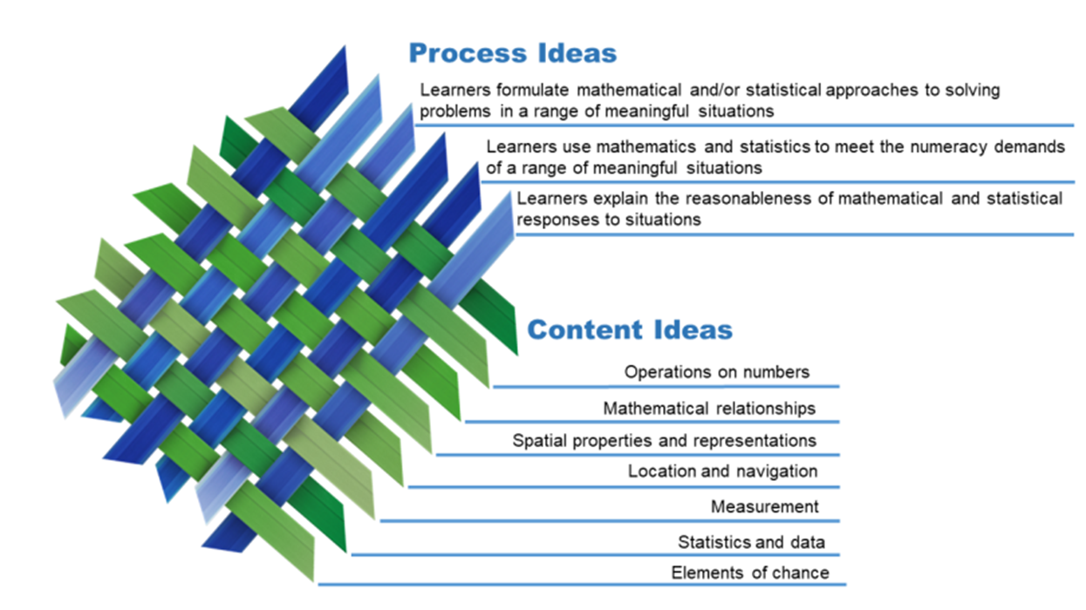
The Numeracy standard

Slide 18
The Reading Standard
Read to make sense of written texts.
Process information and identify important ideas.
Make links within texts using text structures and language features.
Identify the meaning of vocabulary essential to understanding the text.
Read written texts with critical awareness.
Identify and make links between audience, purpose, and writer point-of-view.
Evaluate the reliability and credibility of the text and/or the writer.
Read written texts for different purposes.
Select and evaluate the relevance of texts according to the reader’s purpose.
Locate and use information across a rangeof texts according to the reader’s purpose.
The Writing Standard
Write meaningful texts for different purposes
and audiences
Select and use content that is appropriate to purpose and audience
Use text structures in ways that are appropriate to purpose, audience and text
Make language choices that are appropriate to purpose and audience
Write text that demonstrates sufficient technical accuracy to communicate meaning, without intrusive errors in spelling, punctuation or grammar
Use written language conventions to support communication
Construct a variety of complete sentences
Punctuate correctly to support meaning
Use grammatical conventions within sentences and paragraphs with sufficient technical accuracy to communicate meaning
Use and spell everyday high frequency vocabulary with technical accuracy
Make simple changes to improve text coherence and the organisation of content
Notes:
LALs – Margaret
The outcomes and performance criteria on the right need to be demonstrated in the CAA 9on the left). The markers’ report indicates the following areas as needing attention:
completing all sections of the assessment, meeting all requirements of the standard (e.g. text length, text formality), and taking note of reminders such as ‘use appropriate paragraphs and punctuation’
using the planning space to organise their ideas
addressing the topic appropriately with sufficient examples and detail
recognising the difference between ‘written’ and ‘spoken’ language; using language that is appropriate for the context
editing and/or proofreading their work for content, structure, language appropriateness, and technical accuracy
Next slide - Handover to Karen

Slide 19
Current pedagogical resources
Effective relationships that support NCEA Literacy and Numeracy
Effective practices that support NCEA Literacy
Effective practices that support NCEA Numeracy
Literacy Pedagogy Guides (LPGs) and Numeracy Pedagogy Guides (NPGs)
What is Literacy and What is Numeracy
A guide for ākonga and whānau
Readiness tools

Slide 20
Break out room conversation (15 minutes)
Discussion:
“How can the pre-entry Literacy/Numeracy assessment add value for students once in their programmes, and be used formatively by academic staff?
Notes:
(Do we want a record of what participants talk about ? i.e. do we need the ‘breakout recording sheet?)
Talk about not going into the breakout rooms as it disrupts flow but that we will keep an eye on what’s written on the slides. If you need some help you can communicate by….
You’re now going to go into breakout rooms to share your experiences and make some decisions about where to next.
To do that, you will need this link (share the link in the chat) that has been sent to you in the chat. Click on the link and open it; you should see (describe what they will see).
At the end of the session, we will remove your access to this document. However, you will be sent notes summarising the discussion in the next few days.
It will take a minute or so for them to get sorted. Ask them to give a thumbs up if they have opened it. Thumbs down if they haven’t (you’ll get a mix of physical thumbs and emoji thumbs). If most of them are in, you should be fine; if one or two can’t get there, someone else in their breakout room can share a screen.
You will see that there are a number of slides there that all look the same. When you are in breakout rooms, you will find the slide number that is the same as your breakout room number. Ie if you’re in breakout room 1, you’ll type on slide 1. If you’re in breakout room 7, you’ll type on slide 7.
You could now ask someone to paraphrase the instructions, just to check that they are clear.
You’re going into breakout rooms now; remember that you can ask for me to come into your breakout room, otherwise I’ll just be reading what you are writing.
Need to add the link to the google slides presentation here: Where are you up to now 20 Oct 2021 PARTICIPANT ACTIVITY.pptx
While they are in the breakout rooms, send them a message suggesting that they share emails.

Slide 21
Previously Education Knowledge Lounge
He aha te huarahi? I runga i te tika, te pono me te aroha
What is the pathway? It is doing what is right, with integrity and compassion.
Join in to listen, discuss, and debate with colleagues ideas about evidence-based education. Who should attend:
Kaiako, teachers, leaders, policy makers, researchers, anyone contributing to making a difference in education!
Join our first session – “The Future of learning in a post-Covid world”
Date: 19th May, 4.00-5:30 pm

Slide 22
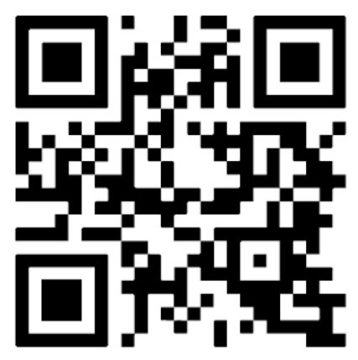
Kukari Newsletter for ITE students

Slide 23
Notes:
The whare is held up by ngā pou o te whare | the pillars of the house – which depict the work that needs to be undertaken to contribute to a strong and effective profession. The four central pou represent the values of the teaching profession and of the Council – whakamana, manaakitanga, pono and whanaungatanga. These pou remind us of the primary purpose of the whare – to do all that we can together to ensure learners/ākonga are given the right support in order to fulfill their aspirations and those of their whānau and communities.

Slide 24
Karakia Whakakapi
Karakia Whakakapi Kua ea ki runga Kua ea ki raro E Rongo whakairihia ki runga kia tina. Tina! Haumi ē! Hui ē! Taiki ē! | Closing Affirmation It has been completed above It has been competed below Let peace be suspended on high as a beacon to guide us. Let us unite! Let us gather together! Let us secure our purpose!

Slide 25
Level 11, 7 Waterloo Quay, Wellington 6011, NZ

